Slide 1
Data Structures Workshop
Day 16

Slide 2
Workshop Outline
Hash Tables and Hashing Techniques
Direct Hashing
Linear Probing
Quadratic Probing
Double Hashing
Separate Chaining
C++ Maps

Slide 3
Hashing

Slide 4
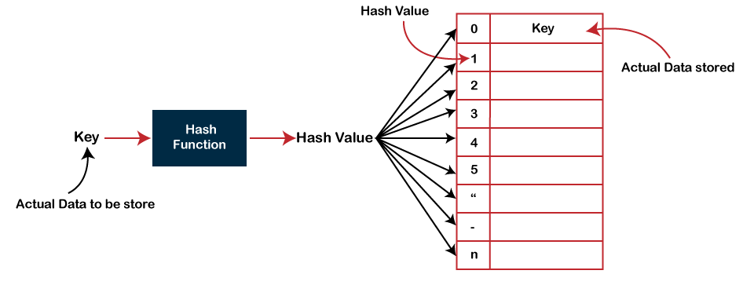
Hashing
Hashing is the process of mapping keys onto a table with the use of a hash function
Each key’s value in hash table must be UNIQUE
Efficiency is dependent on which hash function is used

Slide 5
Hash Table
This is the structure we’ll be using to store these key-value pairs
Key → Actual Value we Want to Store
Value → “Hash Index”
Allows for fast access to elements in an array since each key will have a value associated with it (index of where to find it in our hash table)
Quick insertion, deletion and searching
Avg = O(1), Worst = O(n)

Slide 6
Collision Handling
Collision: occurs when two (or more) keys are hashed to the same index in a hash table
When this happens, you need to find another place in the hash table to map the key to, since each key needs to have a unique value.
Ideally, you don’t want collisions to happen at all, but they will. You want to use a hashing function that distributes elements uniformly over the hashing table (so less collisions occur)
We will cover how different hashing techniques deal with these collisions

Slide 7
Direct Hashing

Slide 8
Direct Hashing
Simplest hashing technique to implement!
h(x) → Hash Value (index where key will go in table)
h(x) = key % tableSize
Though it’s the simplest to implement, it comes with some drawbacks:
Has non existent collision handling
Data is overwritten when a collision occurs (data is lost)

Slide 9
Direct Hashing Tracing
Let’s say we have to insert 19, 50, 89, 39
Hash function: h(x) = key % 5
0
1
2
3
4
h(19) = 19 % 5 = 4​
Resolves issues with collisions by simply overwriting previous value.
Issue: We end up overwriting some values in our hash table (we now lose access to them)
​
​
50
h(50) = 50 % 5 = 0
h(89) = 89 % 5 = 4
h(39) = 39 % 5 = 4​
19
89
39

Slide 10
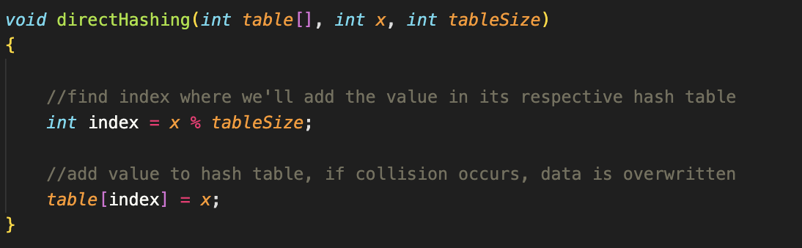
Code Implementation

Slide 11
Linear Probing

Slide 12
Linear Probing
After collision occurs, linearly look for next available index in the hash table where the key can be mapped to
This is implementation ensures that every single key is stored at a specific location​ (no loss of data)
Downside is “clustering”, where many consecutive elements form groups and can cause time it takes to find a free slot to increase
h(x) = (h(x) + i) % tableSize

Slide 13
Linear Probing Tracing
This resolves collisions by simply incrementing and trying again.​
Issue: When values are clustered we increase our search time O(n).​
Let’s say we have to insert 19, 50, 89, 39
Hash function: h(x) = ((key % 5) + i ) % 5
0
1
2
3
4
50
h(19) = ((19 % 5) + 0) % 5 = 4
89
h(50) = ((50 % 5) + 0) % 5 = 0
39
h(89) = ((89 % 5) + 0) % 5 = 4 COLLISION, Increment i
h(89) = ((89 % 5) + 1) % 5 = 0 COLLISION, Increment i
19
h(89) = ((89 % 5) + 2) % 5 = 1

Slide 14
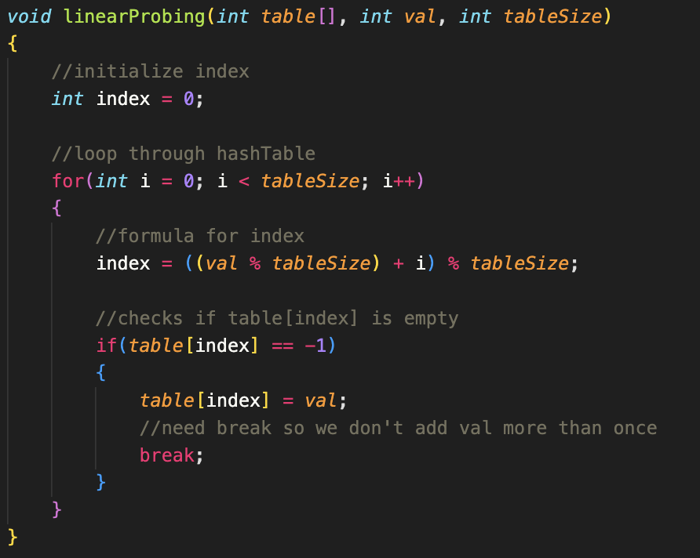
Code
Implementation

Slide 15
Quadratic Probing

Slide 16
Quadratic Probing
Follows the same idea as linear probing, but now instead of linearly looking for next available index in the hash table when a collision occurs, we’ll iterate by i^2
This eliminates the amount of clustering that occurs from linear probing, so inserting and searching is faster
h(x) = (h(x) + (i * i)) % tableSize

Slide 17
Quadratic Probing Tracing
This resolves primary clustering.​
Issue: We ran into an infinite loop
​
You have to be very careful in the kind of hashing technique you select.​
​
​
Let’s say we have to insert 19, 50, 89, 39
Hash function: h(x) = (h(x) + (i * i) % 5
0
1
2
3
4
50
h(19) = 19 % 5 = 4
h(50) = 50 % 5 = 0
h(89) = 89 % 5 = 4
89
h(39) = 39 % 5 = 4
19

Slide 18
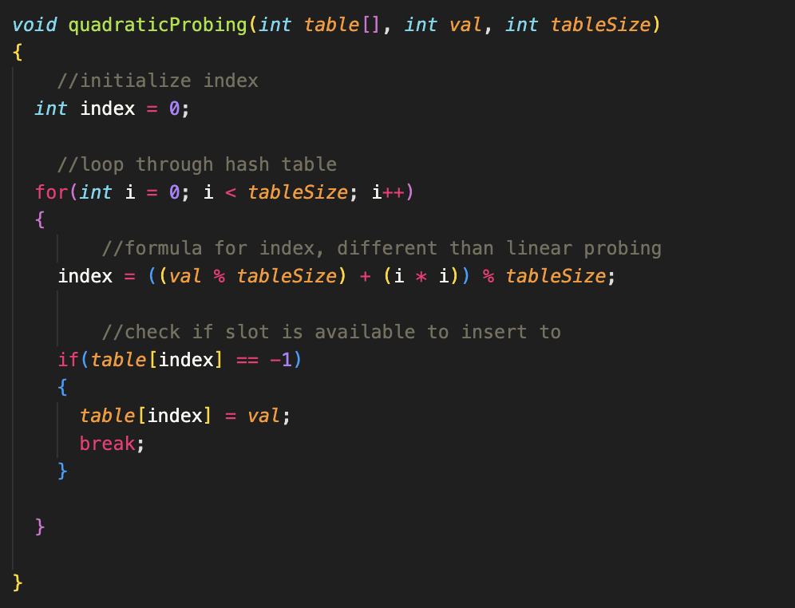
Code
Implementation

Slide 19
Double Hashing

Slide 20
Double Hashing
When a collision occurs, we use a second hash function to find an empty index in our hash tables
hash1() = key % tableSize​
hash2() = primeNum - (key % primeNum)
h(x) = ((hash1) + (i * hash2)) % tableSize​
​
​
We have two hash functions to give us a much more efficient and highly distributed value.
We only use the second hash when there is a collision, until then the i = 0

Slide 21
Double Hashing Tracing
Remember: We only use the second hash when there is a collision, until then the i = 0
Lets we have to insert 19, 50, 89, 39
Hash Function | 19 | 50 | 89 | 39
h1(x) = key % 5
h2(x) = 3 - (key % 3)
Final Hash: h1(x)+ i * h2(x)
0
1
2
3
4
Follow trace on board!

Slide 22
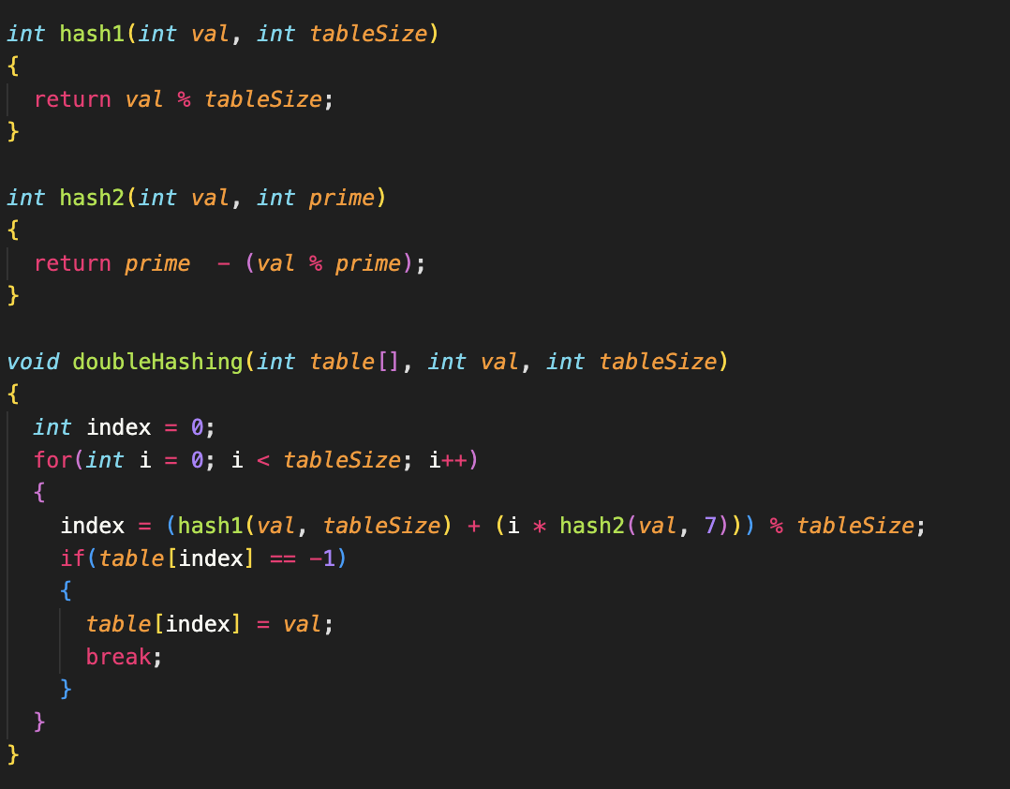
Code
Implementation

Slide 23
Separate Chaining

Slide 24
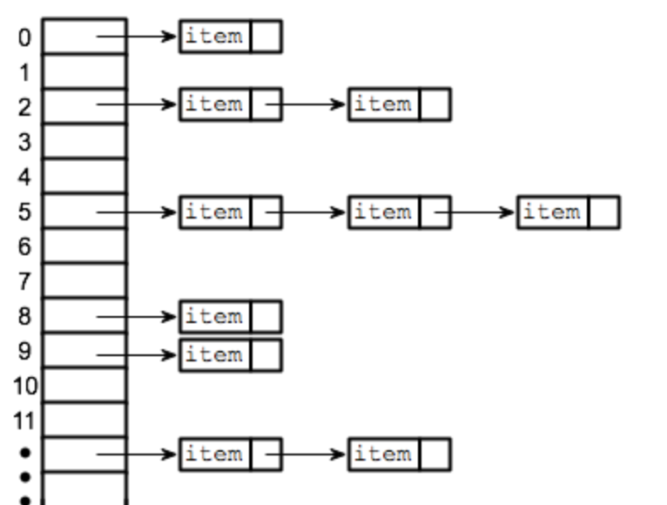
Separate Chaining
This hashing method uses linked lists to save values with the same hash function index.
Our hash table never can get “full” since we can always continue to add values to each cell’s respective “chain”
Search time can become O(n) if values keep getting added to the same hash index

Slide 25
Open Chaining Tracing
Collisions are handled by using Linked Lists at the “head” of every index in our Hash Table!
Let’s say we have to insert 19, 50, 89, 39
0
1
2
3
4
50
h(19) = 19 % 5 = 4
h(50) = 50 % 5 = 0
h(89) = 89 % 5 = 4
h(39) = 39 % 5 = 4
19
89
39

Slide 26
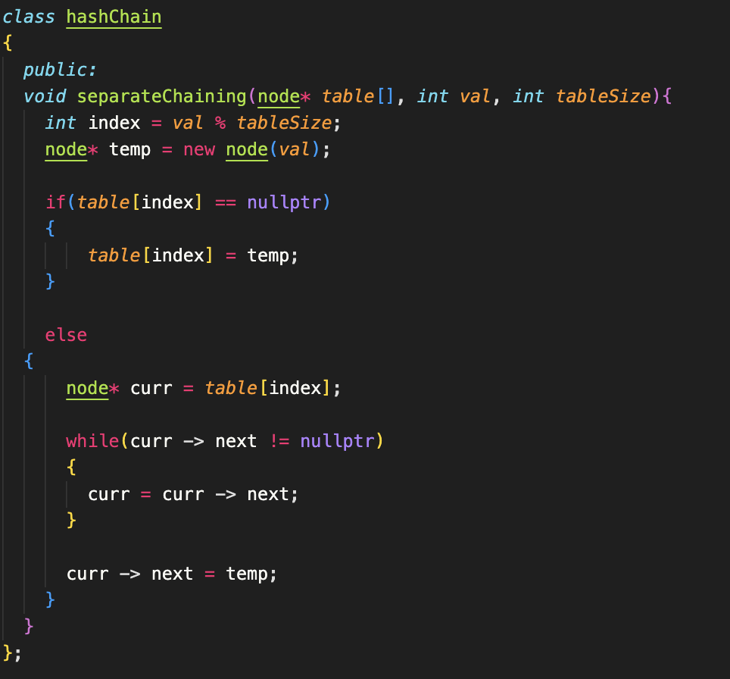
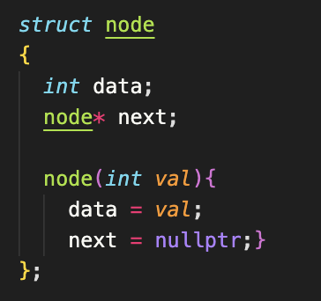
Code
Implementation
Possible Exam 2 Question

Slide 27
Maps

Slide 28
C++ Maps
Sort of hash table that is part of C++ STL
Made up of 2 components: key value and a mapped value
Key → used to sort and identify the elements in the map
Mapped Value → stored the data that’s associated with specific key
Can be no duplicates in a map
Mapped values for a key can be accessed using the bracket operator

Slide 29
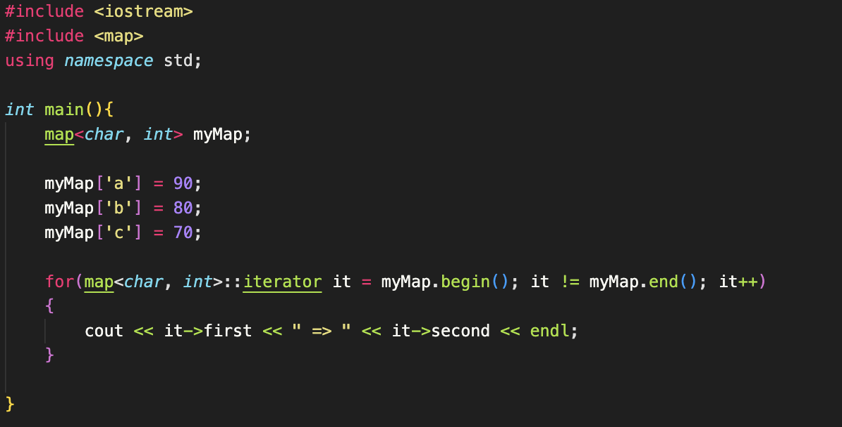

Implementation of Maps
Output:

